Slide 1
AES Implementation
Ana Sharma - 801432222

Slide 2
Improved Sections in the AES.c Source Code:
Data Types
Conditionals
Key Expansion
Substitution
Encrypt Function

Slide 3
Data Types:
#include <stdint.h> is required for using uintxx_t and uintxx_t* data types.
uint64_t is favored over unsigned short for storing integers.
Provides 64-bit precision for cryptographic key properties.
uint8_t is used for handling byte-level data like plaintext, ciphertext, and key bytes.

Slide 4
//unsigned integer
typedef struct AESkey {
uint64_t Nk; // Number of 32-bit words in the key
uint64_t Nr; // Number of AES rounds
uint64_t Nb; // Number of 32-bit words in a block
uint64_t wLen; // Length of the expanded key
uint64_t keylen; // Key length in bytes
uint8_t *key; // Pointer to AES key bytes
} *aeskey_t;

Slide 5
Conditionals
aeskey_t aeskey_init(uint64_t kappa)
{...
}
if (out->Nk==4)
{
out->Nr=10;
out->wLen = 176;
}
else if (out->Nk==6)
{
out->Nr=12;
out->wLen = 208;
}
else if (out->Nk==8)
{
out->Nr=14;
out->wLen = 240;
}
For optimizing speed and minimizing looping, using if-else statements is generally preferred over switch cases.
If-else statements evaluate specific conditions individually, while a switch statement assesses multiple scenarios simultaneously.

Slide 6
• Minimizing memory allocation within each loop iteration.
• Directly accessing 'w' instead of generating a temporary array.
Key Expansion:
// Initialize the number of 4-byte words in the key during the for loop initialization
// Loop Condition: Verify if # is less than four times the number of rounds plus one
// 'For' Loop Modification => Increment
int KeyExpansion(aeskey_t key, uint8_t w[]){
…
for (i=Nk; i<4*(Nr+1); i++)
{
// Verify if the result of dividing the number of 4-byte words in the key by rounds equals 0
if ((i % Nk) == 0) {
w[4*i] = w[4*(i-Nk)] ^ (sbox[w[4*(i-1)+1]] ^ Rcon[i/Nk]);
w[4*i+1] = w[4*(i-Nk)+1] ^ (sbox[w[4*(i-1)+2]]);
w[4*i+2] = w[4*(i-Nk)+2] ^ (sbox[w[4*(i-1)+3]]);
w[4*i+3] = w[4*(i-Nk)+3] ^ (sbox[w[4*(i-1)]]);

Slide 7
// Otherwise, verify whether the count of 4-byte words equals 8 and if the remainder when dividing the number of 4-byte words in the key by rounds is 4
else if ((Nk ==8) && ((i%Nk)==4))
{
w[4*i] = w[4*(i-Nk)] ^ (sbox[w[4*(i-1)]]);
w[4*i+1] = w[4*(i-Nk)+1] ^ (sbox[w[4*(i-1)+1]]);
w[4*i+2] = w[4*(i-Nk)+2] ^ (sbox[w[4*(i-1)+2]]);
w[4*i+3] = w[4*(i-Nk)+3] ^ (sbox[w[4*(i-1)+3]]);
// Final condition check
} else {
w[4*i] = w[4*(i-Nk)] ^ w[4*(i-1)];
w[4*i+1] = w[4*(i-Nk)+1] ^ w[4*(i-1)+1];
w[4*i+2] = w[4*(i-Nk)+2] ^ w[4*(i-1)+2];
w[4*i+3] = w[4*(i-Nk)+3] ^ w[4*(i-1)+3];
}
}
return 0;
}

Slide 8
Substitution
// Enhances byte substitution efficiency by aligning the cipher array size with the substitution box, optimizing performance by bypassing the increment/counter static void SubBytes(uint8_t cipher[]) {
cipher[0]=sbox[cipher[0]];
cipher[1]=sbox[cipher[1]];
cipher[2]=sbox[cipher[2]];
cipher[3]=sbox[cipher[3]];
cipher[4]=sbox[cipher[4]];
…
cipher[14]=sbox[cipher[14]];
cipher[15]=sbox[cipher[15]];}
Splitting the for loops into separate statements to enhance performance.

Slide 9
Encrypt Function
for (k=1; k<key->Nr; k++) {
SubBytes(cipher);
ShiftRows(cipher);
MixColumns(cipher);
//for (j=0;j<16;j++) cipher[j]^= w[16*k+j];
// Bitwise exclusive OR is employed for generating arrays of ciphers and key lengths
// To boost velocity, the for loop was eliminated
cipher[0] ^=w[16*k+0];
cipher[1] ^=w[16*k+1];
…
// Bitwise exclusive OR is employed for generating arrays of ciphers and key lengths
// To boost velocity, the for loop was eliminated
cipher[0] ^=w[16*(key->Nr)+0];
cipher[1] ^=w[16*(key->Nr)+1];
…
cipher[15]^=w[16*(key->Nr)+15];
Exclusively OR (Ex-OR) operation is executed here, specifically for both the key length and array ciphers.

Slide 10
F256mul: replacing switch with if statements
static uint8_t f256mul(uint8_t b, uint8_t a) {
if (b == 0x09)
return f256times2(f256times2(f256times2(a))) ^ a;
else if (b == 0x0b)
return f256times2(a ^ f256times2(f256times2(a))) ^ a;
else if (b == 0x0d)
return f256times2(f256times2(a ^ f256times2(a))) ^ a;
else if (b == 0x0e)
return f256times2(a ^ f256times2(a ^ f256times2(a)));
else
return 0x00; // Returning 0 for invalid multipliers
}
// To optimize speed and prevent unnecessary loops, using if and else if statements is more advantageous than employing switch cases

Slide 11
Inverse mix: Linear math doubles encryption speed
u = ((a[3]<<1) ^ (0x1B & (uint8_t)((int8_t) a[3]>>7)));
v = ((u<<1) ^ (0x1B & (uint8_t)((int8_t) u>>7)));
w = ((v<<1) ^ (0x1B & (uint8_t)((int8_t) v>>7))) ^ a[3];
u = ((a[2]<<1) ^ (0x1B & (uint8_t)((int8_t) a[2]>>7))) ^ a[2];
v = ((u<<1) ^ (0x1B & (uint8_t)((int8_t) u>>7)));
x = ((v<<1) ^ (0x1B & (uint8_t)((int8_t) v>>7))) ^ a[2];
…
u = ((a[0]<<1) ^ (0x1B & (uint8_t)((int8_t) a[0]>>7))) ^ a[0];
v = ((u<<1) ^ (0x1B & (uint8_t)((int8_t) u>>7))) ^ a[0];
j = ((v<<1) ^ (0x1B & (uint8_t)((int8_t) v>>7)));
// The binary left shift operators were employed for left-shifting by the specified number of bits on the right
// When a bit is present in one operand but not the other, binary XOR operations duplicate it

Slide 12
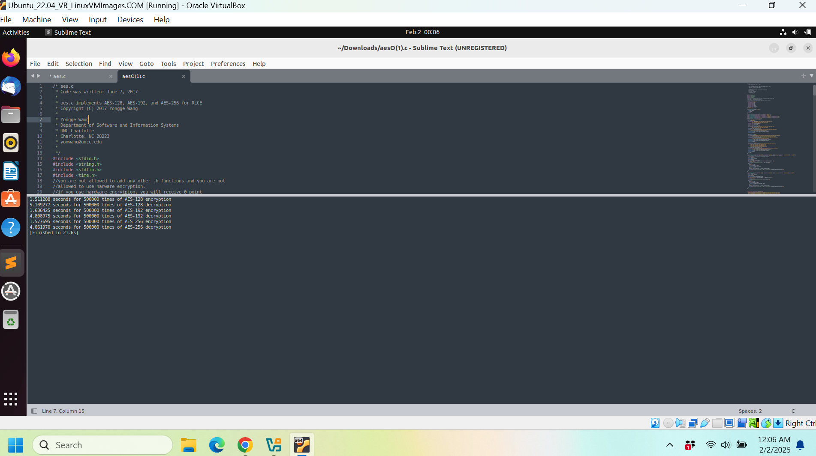
Screenshots
Before:

Slide 13
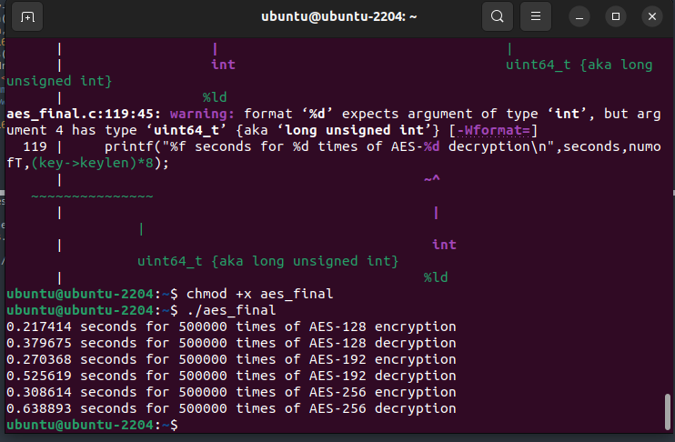
Screenshots
After:

